Slide 1
9 METHODS OF BUSINESS VALUATION
CA TARUN JAGDISH
REGISTERED VALUER

Slide 2

10.5 Billion $

Slide 3
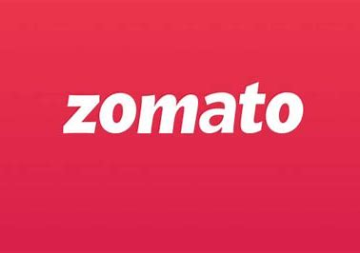
8.50 Billion $

Slide 4

9
Billion $

Slide 5
ZOMATO VS SWIGGY

Slide 6
Zomato has a whooping valuation of 8.50 Billion dollars as against 9 Billion dollars for swiggy

Slide 7
This makes Swiggy the highest valued Food Tech

Slide 8
Do you know all these companies are running at Huge Losses

Slide 9
Financials
PARTICULARS | SWIGGY | ZOMATO
Revenue | 2956 cr | 2486 cr
Expense | 6864 cr | 4937 cr
Loss | 3909 cr | 2451 cr

Slide 10
Investor Group
Investor Group
Zomato
Swiggy
Glade Brook Capital
CDH Investments
ANT Financials
Info edge
Innoven Capital
Korea Investment Partners
Mirae Assets

Slide 11
PARTICULARS | ZOMATO | SWIGGY
Number of deliveries per day | 1.25 million orders | 1.40 million orders
Percentage of smart phones | 12% | 10%

Slide 12
LESSON
If your business is at a loss, it doesn’t mean that your value is negative
Value is dependant on future cashflow not on past cashflow

Slide 13
9 METHODS OF START UP VALUATION
CA TARUN JAGDISH
Registered Valuer

Slide 14
PROBLEMS FACED BY START UPS
No records
Minuscule or no revenues, working losses
Depending on non-public equity
Many don’t live on
Various claims on value
Investments are illiquid

Slide 15
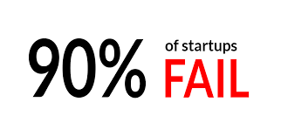

Slide 16
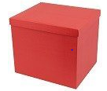
Valuation For Startups – 9 Methods

Slide 17
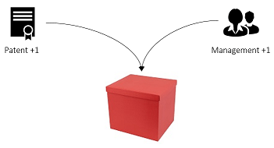
Valuation For Startups – 9 Methods
The box has a value. The more things you put in the box, the more its value increases. Add a patent in the box, the value increases. Add a kick-ass management team in the box, the value increases. Easy, right?
Your startup is now worth 2.

Slide 18
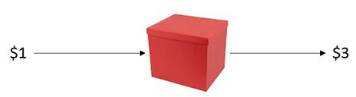
Valuation For Startups – 9 Methods
The box is also magic. When you put Rs 1 inside, it will return you Rs2, Rs3 or even Rs10! Amazing!
I want to build one of those little boxes for myself!

Slide 19
Valuation For Startups – 9 Methods
Problem is, building a box can be very expensive. So you need to go and see people with money — let’s call them investors — and offer them a deal that sounds a bit like this:
“Give me 1Million to build a box, and you get X% of everything that comes out of it”
But how much should “X” be?
It depends on the Pre-Money Valuation, e.g. the value of the box at the moment of the investment. But calculating the Pre-Money Valuation is tricky.

Slide 20
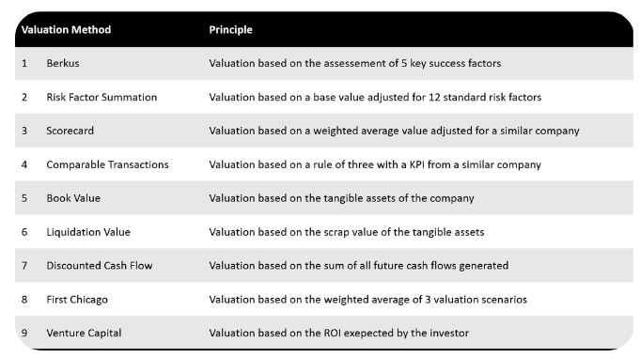
Valuation For Startups – 9 Methods

Slide 21
BERKUS METHOD
1. Value your startup with the Berkus Method
The Berkus Method is a simple and convenient rule of thumb to estimate the value of your box. First, you have to know how much a similar box is worth. Then, you assess how you perform in the 5 key criteria for building boxes.

Slide 22
Berkus …..
First, Berkus says that investors should believe the company has a potential to hit $2 million in value or more by the 5th year of operation. Then, he applies a scale to five components of a startup, rating each at up to $400,000. The components are:

Slide 23
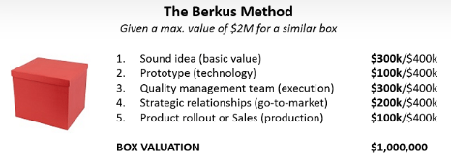

Slide 24
RISK FACTOR SUMMATION METHOD
2. Value your startup with the Risk Factor Summation Method
The Risk Factor Summation Method or RFS Method is a slightly more evolved version of the Berkus Method.
First, you determine an initial value for your box.
Then you adjust said value for 12 risk factors inherent to box-building.

Slide 25
RISK FACTOR SUMMATION METHOD
Initial value is determined as the average value for a similar box in your area
Risk factors are modelled as multiples of $250k, ranging from $500k for a very low risk, to -$500k for a very high risk.
The most difficult part here, and in most valuation methods, is actually finding data about similar boxes.

Slide 26
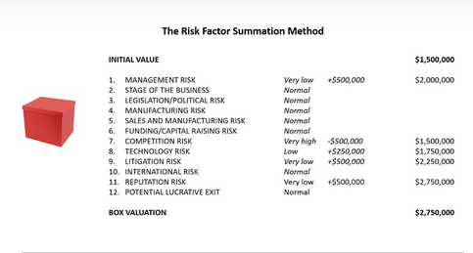

Slide 27
SCORE CARD VALUATION
3. Value your startup with the Scorecard Valuation Method
The Scorecard Valuation Method is a more elaborate approach to the box valuation problem. It starts the same way as the RFS method i.e. you determine a base valuation for your box, then you adjust the value for a certain set of criteria.
Nothing new, except that those criteria are themselves weighed up based on their impact on the overall success of the project.

Slide 28
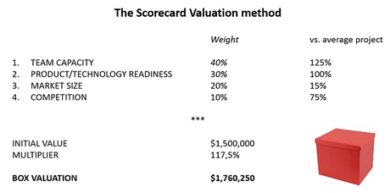

Slide 29
Nine Valuation Methods
The Scorecard Valuation Method is meant for pre-revenue startups.

Slide 30
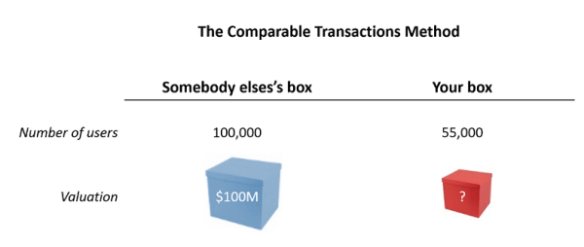
Comparable Transaction Method
.
4. Value your startup with the Comparable Transactions Method
The Comparable Transactions Method is really just a rule of three.

Slide 31
Comparable Transaction Method
Depending on the type of box you are building, you want to find an indicator which will be a good proxy for the value of your box.
This indicator can be specific to your industry: Monthly Recurring Revenue (Saas), HR headcount (Interim), Number of outlets (Retail), Patent filed (Medtech/Biotech), Weekly Active Users or WAU (Messengers).
Most of the time, you can just take lines from the P&L : sales, gross margin, EBITDA, etc.

Slide 32
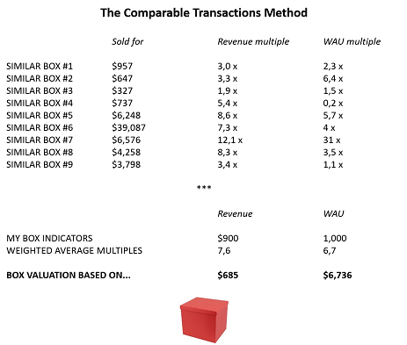
Nine Valuation Methods
.

Slide 33
BOOK VALUE METHOD
5. Value your startups with the Book Value Method
Forget about how magical the box is, and see how much 1kg of cardboard is worth.
The book value refers to the net worth of the company i.e. the tangible assets of the box i.e. the “hard parts” of the box.

Slide 34
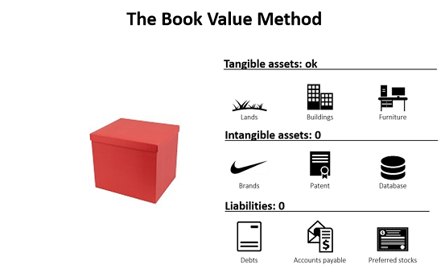

Slide 35
LIQUIDATION VALUE
6. Value your startup with the Liquidation Value Method
1. Rarely good from a seller perspective, the liquidation value is, as implied by its name, the valuation you apply to a company when it is going out of business.
2. Things that counts for a liquidation value estimation are all the tangible assets:
3. All the intangibles on the other hand are considered worthless in a liquidation process
4. Practically, the liquidation value is the sum of the scrap value of all the tangible assets of the company.

Slide 36
DCF METHOD
7. Value your startup with the Discounted Cash Flow method
If your box works well, it brings in a certain amount of cash every year. Consequently, you could say that the current value of the box is the sum of all the future cash flows over the next years. And that is exactly the reasoning behind the DCF method.

Slide 37
FIRST CHICAGO METHOD
8. Value your startup with the First Chicago Method
The First Chicago Method answers to a specific situation: what if your box has a small chance of becoming huge? How to assess this potential?

Slide 38
FIRST CHICAGO METHOD
The First Chicago Method (named after the late First Chicago Bank — if you ask) deals with this issue by making three valuations:
→worst case scenario
→ Normal case scenario
→ a best case scenario

Slide 39
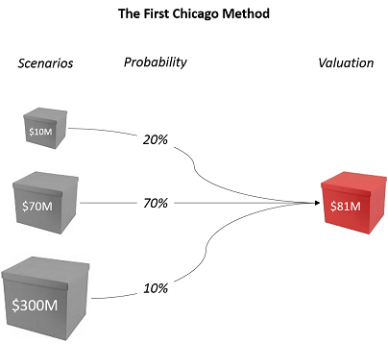

Slide 40
Venture Capital Method
9. Value your startup with the Venture Capital Method
As its name indicate, the Venture Capital Method stands from the viewpoint of the investor.

Slide 41
Venture Capital Method
An investor is always looking for a specific return on investment, let’s say 20x. Besides, according to industry standards, the investor thinks that your box could be sold for $100M in 8 years. Based on those two elements, the investor can easily determine the maximum price he or she is willing to pay for investing in your box, after adjusting for dilution.

Slide 42
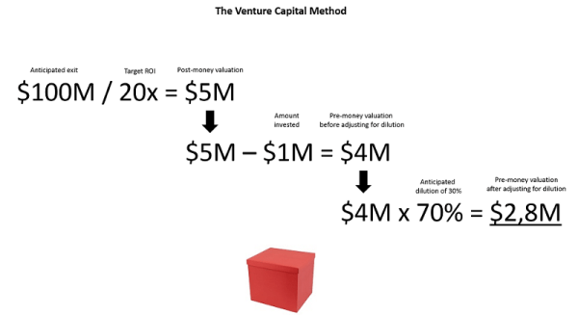
Nine Valuation Methods

Slide 43
Thank You

